Slide 1
More about Meta Learning
Hung-yi Lee

Slide 2
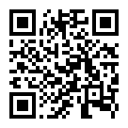
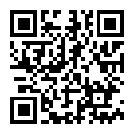
Prerequisite
https://youtu.be/xoastiYx9JU
https://youtu.be/Q68Eh-wm1Ts

Slide 3
Outline
Meta Learning vs. Self-supervised Learning
Meta Learning vs. Domain Generalization
Meta Learning vs. Knowledge Distillation
Meta Learning vs. Life-long Learning
Notes:
Self- upsupervised
KD
Domain
Life-long

Slide 4
Meta Learning vs. Self-supervised Learning
Notes:
Check: to learn more
====
TBD: try to include “Meta Fine-Tuning”
====
TBD: try to include “Multi-source Meta Transfer for Low Resource Multiple-Choice Question Answering” -> mentioned in part 2 anyway …
====
d parameters initialization for fast adaptation to new tasks. [31, 46, 2] introduce metalearning to Domain Generalization (DG) to synthesize the source-target domain shift during training.
-- [2] Yogesh Balaji, Swami Sankaranarayanan, and Rama Chellappa. Metareg: Towards domain generalization using metaregularization. In NeurIPS, pages 998–1008, 2018. 3, 8, 14
-- [10] Qi Dou, Daniel Coelho de Castro, Konstantinos Kamnitsas, and Ben Glocker. Domain generalization via model-agnostic learning of semantic features. In NeurIPS, pages 6450–6461, 2019. 3, 5, 8, 14
-- [31] Da Li, Yongxin Yang, Yi-Zhe Song, and Timothy M Hospedales. Learning to generalize: Meta-learning for domain generalization. AAAI, 2018. 3, 5, 8, 14
-- [46] Fengchun Qiao, Long Zhao, and Xi Peng. Learning to learn single domain generalization. In CVPR, pages 12556–12565, 2020.
=====
--Li et al. [29] adopt MAML to provide better initialization condition for Multi-Source Domain Adaptation.
[29] Da Li and Timothy Hospedales. Online meta-learning for multi-source and semi-supervised domain adaptation. In ECCV, pages 382–403, 2020

Slide 5
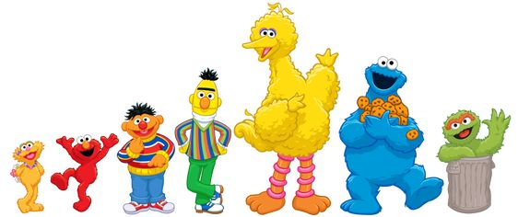
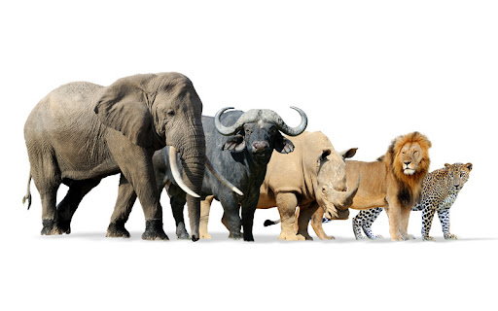
Meta Learning vs. Self-supervised Learning
Self-supervised Learning
(BERT and pals)
Learn to Init (MAML family)
Notes:
state-of-the art language models mostly utilize self-supervised tasks during pretraining
This unavoidably creates a “learning gap” between pre-training and fine-tuning
A basic solution is fine-tuning models by multitask learning. Unfortunately, multi-task fine-tuning of BERT does not necessarily yield better performance across all the tasks
=====
Should I talk about this direction?
Using MAML to improve representation learning?
MetaXL: Meta Representation Transformation for Low-resource Cross-lingual Learning, NAACL 2021
Meta Fine-Tuning Neural Language Models for Multi-Domain Text Mining
=====

Slide 6
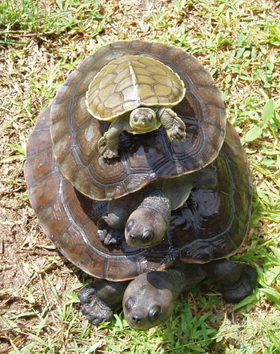
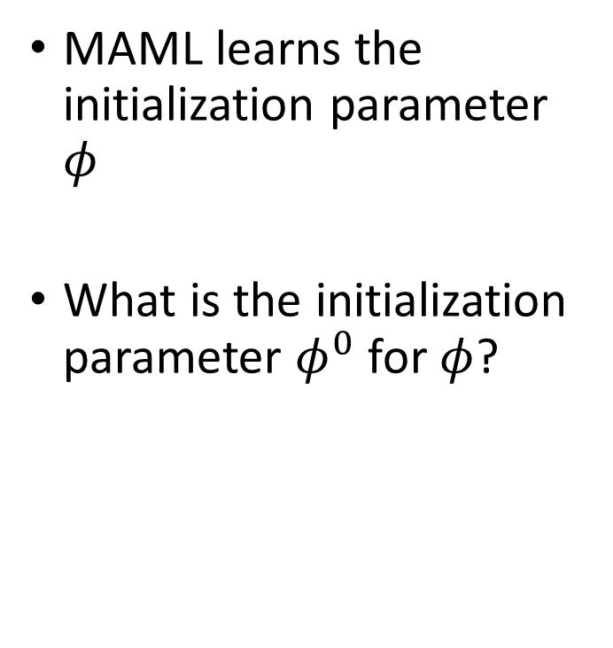
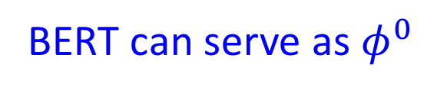
Meta Learning vs. Self-supervised Learning
MAML learns the initialization parameter $φ$
What is the initialization parameter $φ^{0}$ for $φ$?
MAML
by gradient descent
BERT
BERT can serve as $φ^{0}$
Notes:
無限的盡頭
Yann N. Dauphin, Samuel S. Schoenholz, MetaInit: Initializing learning by learning to initialize, NeurIPS, 2019

Slide 7
Meta Learning vs. Self-supervised Learning
MAML
Learn to achieve good performance on training tasks.
Leverage training tasks.
BERT
The self-supervised objectives are different from downstream tasks.
There is a “learning gap”.
Utilize a large amount of unlabeled data
Notes:
無限的盡頭
Yann N. Dauphin, Samuel S. Schoenholz, MetaInit: Initializing learning by learning to initialize, NeurIPS, 2019

Slide 8
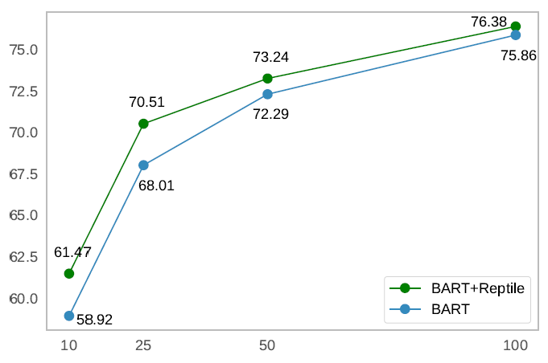
Meta Learning vs. Self-supervised Learning
Reminder domain of TOPv2
SPIS = samples per intent and slot
Xilun Chen, Asish Ghoshal, Yashar Mehdad, Luke Zettlemoyer, Sonal Gupta, Low-Resource Domain Adaptation for Compositional Task-Oriented Semantic Parsing, EMNLP, 2020

Slide 9
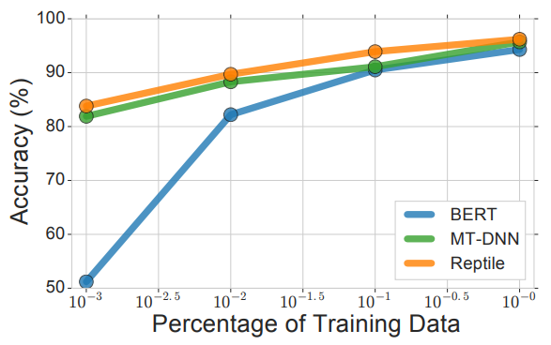
Meta Learning vs. Self-supervised Learning
Testing task: SciTail
Zi-Yi Dou, Keyi Yu, Antonios Anastasopoulos, Investigating Meta-Learning Algorithms for Low-Resource Natural Language Understanding Tasks, EMNLP 2019
Notes:
SciTail is NLP
====
Applied MAML and Reptile on a bunch of tasks in GLUE dataset (four high resource tasks for training and four low resource tasks for testing)

Slide 10
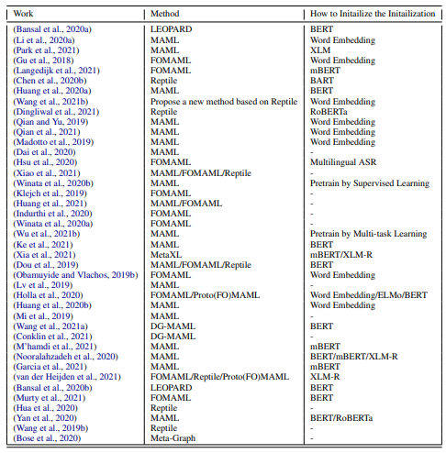
https://arxiv.org/abs/2205.01500

Slide 11
Meta Learning vs. Knowledge Distillation
Notes:
Check: to learn more
====
TBD: try to include “Meta Fine-Tuning”
====
TBD: try to include “Multi-source Meta Transfer for Low Resource Multiple-Choice Question Answering” -> mentioned in part 2 anyway …
====
d parameters initialization for fast adaptation to new tasks. [31, 46, 2] introduce metalearning to Domain Generalization (DG) to synthesize the source-target domain shift during training.
-- [2] Yogesh Balaji, Swami Sankaranarayanan, and Rama Chellappa. Metareg: Towards domain generalization using metaregularization. In NeurIPS, pages 998–1008, 2018. 3, 8, 14
-- [10] Qi Dou, Daniel Coelho de Castro, Konstantinos Kamnitsas, and Ben Glocker. Domain generalization via model-agnostic learning of semantic features. In NeurIPS, pages 6450–6461, 2019. 3, 5, 8, 14
-- [31] Da Li, Yongxin Yang, Yi-Zhe Song, and Timothy M Hospedales. Learning to generalize: Meta-learning for domain generalization. AAAI, 2018. 3, 5, 8, 14
-- [46] Fengchun Qiao, Long Zhao, and Xi Peng. Learning to learn single domain generalization. In CVPR, pages 12556–12565, 2020.
=====
--Li et al. [29] adopt MAML to provide better initialization condition for Multi-Source Domain Adaptation.
[29] Da Li and Timothy Hospedales. Online meta-learning for multi-source and semi-supervised domain adaptation. In ECCV, pages 382–403, 2020

Slide 12
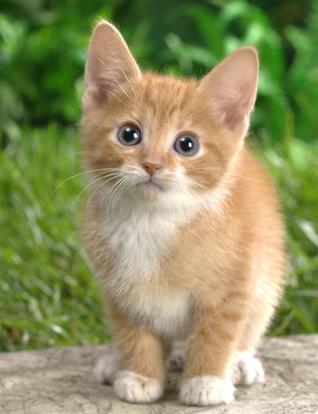
Knowledge Distillation
Cross-entropy minimization
Learning target
“cat”: 0.8, “dog”: 0.2 …
?
Teacher Net
(Large)
Student Net
(Small)
The teacher is not optimized for teaching.

Slide 13
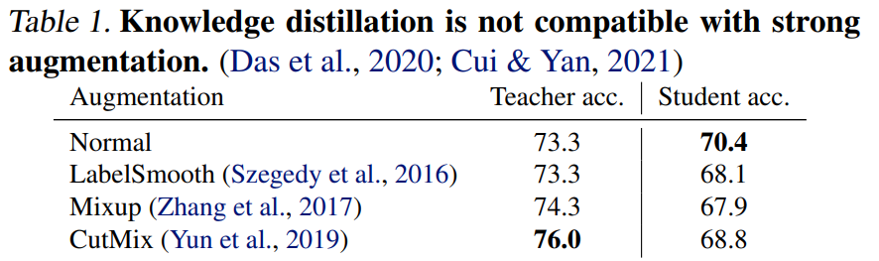
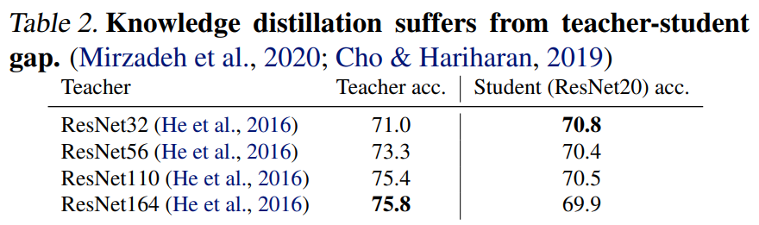
Knowledge Distillation
Source of results: https://arxiv.org/abs/2202.07940
Can the teacher-network “learn to teach”?

Slide 14
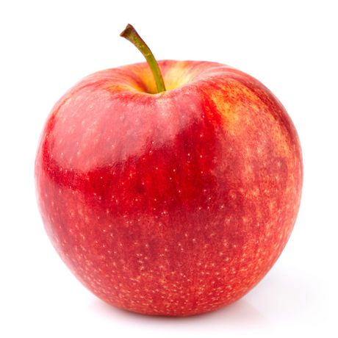
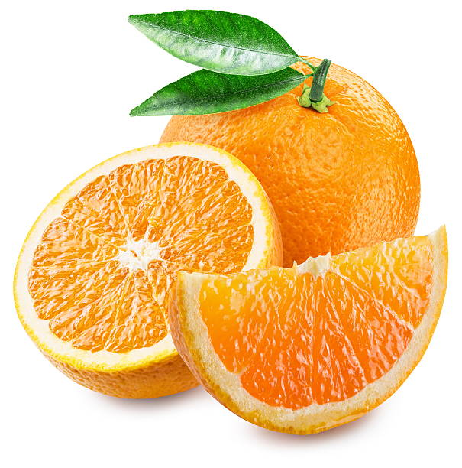
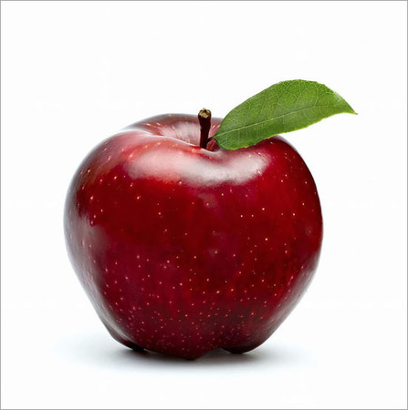
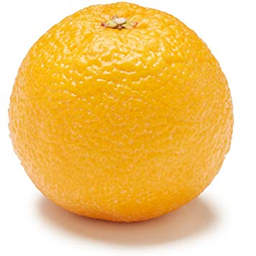
Learn to Teach
Testing loss of student
apple
orange
Knowledge
Distillation
Teacher Net
(Large)
Student Net
(Small)
Update
apple
orange
Wangchunshu Zhou, Canwen Xu, Julian McAuley, BERT Learns to Teach: Knowledge Distillation with Meta Learning, ACL, 2022
Jihao Liu, Boxiao Liu, Hongsheng Li, Yu Liu, Meta Knowledge Distillation, arXiv, 2022

Slide 15
Meta Learning vs. Domain Adaptation
Notes:
Check: to learn more
====
TBD: try to include “Meta Fine-Tuning”
====
TBD: try to include “Multi-source Meta Transfer for Low Resource Multiple-Choice Question Answering” -> mentioned in part 2 anyway …
====
d parameters initialization for fast adaptation to new tasks. [31, 46, 2] introduce metalearning to Domain Generalization (DG) to synthesize the source-target domain shift during training.
-- [2] Yogesh Balaji, Swami Sankaranarayanan, and Rama Chellappa. Metareg: Towards domain generalization using metaregularization. In NeurIPS, pages 998–1008, 2018. 3, 8, 14
-- [10] Qi Dou, Daniel Coelho de Castro, Konstantinos Kamnitsas, and Ben Glocker. Domain generalization via model-agnostic learning of semantic features. In NeurIPS, pages 6450–6461, 2019. 3, 5, 8, 14
-- [31] Da Li, Yongxin Yang, Yi-Zhe Song, and Timothy M Hospedales. Learning to generalize: Meta-learning for domain generalization. AAAI, 2018. 3, 5, 8, 14
-- [46] Fengchun Qiao, Long Zhao, and Xi Peng. Learning to learn single domain generalization. In CVPR, pages 12556–12565, 2020.
=====
--Li et al. [29] adopt MAML to provide better initialization condition for Multi-Source Domain Adaptation.
[29] Da Li and Timothy Hospedales. Online meta-learning for multi-source and semi-supervised domain adaptation. In ECCV, pages 382–403, 2020

Slide 16



Domain Adaptation
Knowledge of target domain
“8”
little &
unlabeled
Large amount of unlabeled data
Little but
labeled
Domain
Generalization

Slide 17
Meta Learning for Domain Generalization
Training domains
Target domain
Good!
Unknown during training
Learning algorithm
Model
e.g., initialization
How to train it?

Slide 18
Meta Learning for Domain Generalization
Training domains
Target domain
Good!
Pseudo target domain
Unknown during training
Good!
Learning algorithm
Model
e.g., initialization

Slide 19
Meta Learning for Domain Generalization
Training domains
Target domain
Training Tasks
Testing Tasks
Notes:
I can add one more page about how to apply maml here

Slide 20
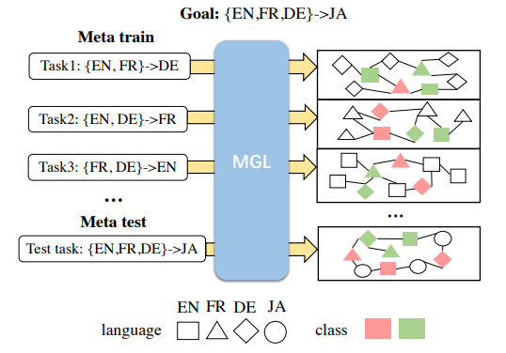
Example – Text Classification
Metric-based Approach
Zheng Li, Mukul Kumar, William Headden, Bing Yin, Ying Wei, Yu Zhang, Qiang Yang, Learn to Cross-lingual Transfer with Meta Graph Learning Across Heterogeneous Languages, EMNLP, 2020
Notes:
Cross-lingual Sentiment Classification

Slide 21



Problem of another level ……
The training examples and testing examples may have different distributions.
Training Examples
Testing Examples
The training tasks and testing tasks can also have different distributions.
Training Tasks
Testing Tasks
Training Tasks
Testing Tasks
Training Tasks
Testing Tasks
Meta learning itself also needs domain adaptation.
Huaxiu Yao, Longkai Huang, Linjun Zhang, Ying Wei, Li Tian, James Zou, Junzhou Huang, Zhenhui Li, Improving generalization in meta-learning via task augmentation, ICML, 2021

Slide 22
Meta Learning vs. Life-long Learning
Notes:
Additional Neural Resource Allocation + meta????
===
Hu Xu, Bing Liu, Lei Shu, and Philip S. Yu. 2018. Lifelong domain word embedding via meta-learning. In Proceedings of the Twenty-Seventh International Joint Conference on Artificial Intelligence, IJCAI18, pages 4510–4516. International Joint Conferences on Artificial Intelligence Organization.
This one does not consider forgeting

Slide 23
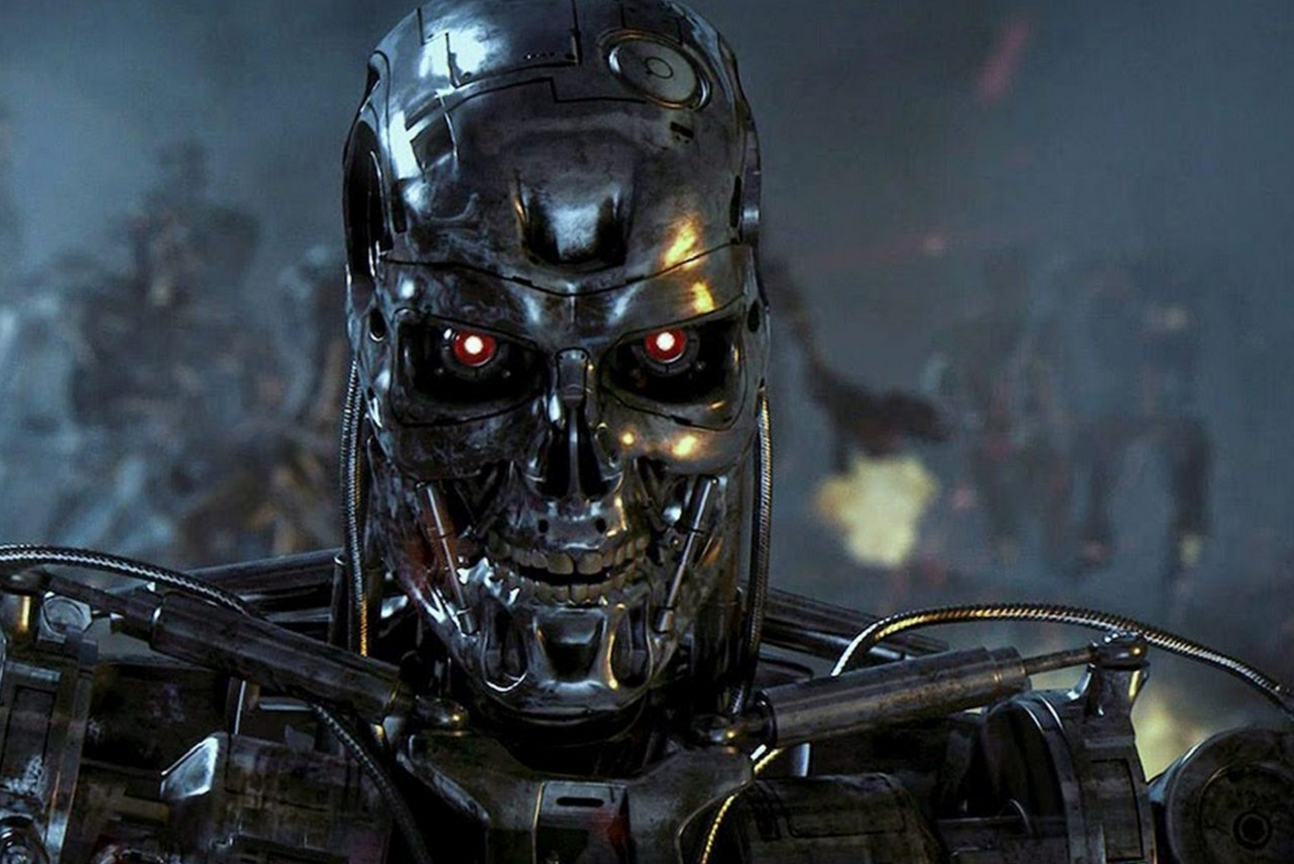
Lifelong Learning Scenario
Dataset
1
Dataset
2
Dataset
3
model
model
model
…
Good at task 1
Good at 1 & 2
Keep learning …
…
…

Slide 24
Lifelong Learning Scenario
Dataset
1
Dataset
2
Dataset
3
model
model
model
…
Good at task 1
Good at 1 & 2
Forget task 1,
Only good at task 2
Catastrophic forgetting!

Slide 25
Mitigating Catastrophic Forgetting
Selective Synaptic Plasticity
Additional Neural Resource Allocation
Memory Replay
Regularization-based
There are already lots of research along each direction.
Can meta learning enhance these approaches?

Slide 26


Regularization-based
Dataset 1
Dataset 2
Learn from the new data
But remember the old data.
cat
dog
cat
dog
Train
$$θ$$
Update
$$θ^{′}$$
Some regularization
L2 does not work. For prevent forgetting: EWC, SI, MAS ……

Slide 27

Regularization-based + Meta
Dataset 1
Dataset 2
Learn from the new data
But remember the old data.
cat
dog
cat
dog
Train
$$θ$$
Update
$$\text{θ}\text{′}$$
satisfy
Learn by meta learning
Find a learning algorithm to prevent catastrophic forgetting.
Nicola De Cao, Wilker Aziz, Ivan Titov, Editing Factual Knowledge in Language Models, EMNLP, 2021
Anton Sinitsin, Vsevolod Plokhotnyuk, Dmitriy Pyrkin, Sergei Popov, Artem Babenko, Editable Neural Networks, ICLR, 2020

Slide 28
Problem of Another Level ……
Dataset
1
Dataset
2
Dataset
3
model
model
model
…
Meta learning can help.
Learning algorithm
Training tasks
Learning algorithm
Training tasks
Learning algorithm
Training tasks
…
Meta learning itself also face the issue of catastrophic forgetting!
Chelsea Finn, Aravind Rajeswaran, Sham Kakade, Sergey Levine, Online Meta-Learning, ICML, 2019
Pauching Yap, Hippolyt Ritter, David Barber, Addressing Catastrophic Forgetting in Few-Shot Problems, ICML, 2021
Notes:
%Task Agnostic Continual Learning via Meta Learning
%%%shift the focus from less forgetting to faster remembering: to rapidly recall a previously learned task, given the right context as a cue.

Slide 29
Concluding Remarks
Meta Learning vs. Self-supervised Learning
Meta Learning vs. Domain Generalization
Meta Learning vs. Knowledge Distillation
Meta Learning vs. Life-long Learning
Notes:
Self- upsupervised
KD
Domain
Life-long

Slide 30
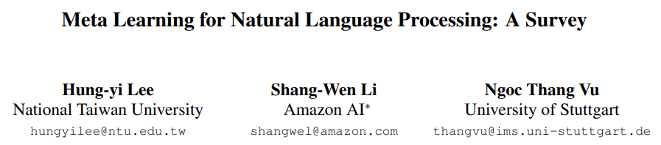
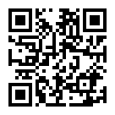
To Learn More ……
https://arxiv.org/abs/2205.01500

Slide 31
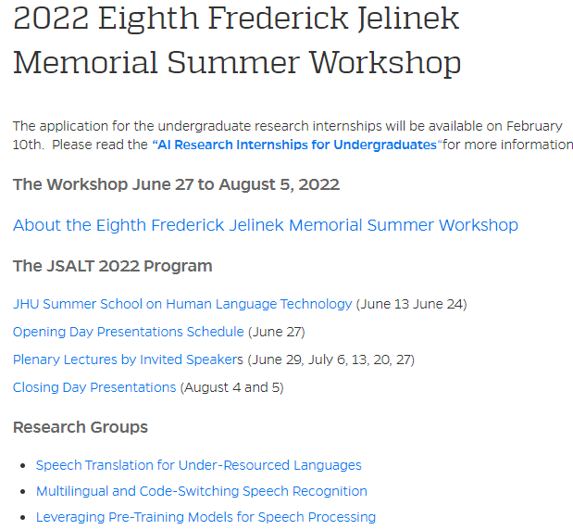
11:10 p.m. (GMT+8)
Notes:
2022 Eighth Frederick Jelinek Memorial Summer Workshop

Slide 32

Thanks for supporting computing resources!

